Slide 1
Intro to Unity Part 1
2D/3D/VR/AR
Notes:
Overview of what will be covered. 2D/3D Virtual Reality & Augmented Reality

Slide 2
What Unity Is
2D / 3D Rendering Engine
Development Environment
Physics
Game Engine
45% of market (next highest is 17%)
3.3M registered devs
Notes:
600M gamers
75% mobile market in china, 50% in us

Slide 3
Uses
Games
Mobile
PC
Console (Xbox/PS/Wii)
Web
Business Apps
Cross Platform
Nice visual effects
Visualization (medical, architectural, etc.)
Augmented Reality (Vuforia)
Virtual Reality
Notes:
Training – Simulation of Tasks
Education – Learning games and apps
Visualization – Buildings & Body Parts
Entertainment – Games / Media
General Cross Platfrom - Home automation

Slide 4
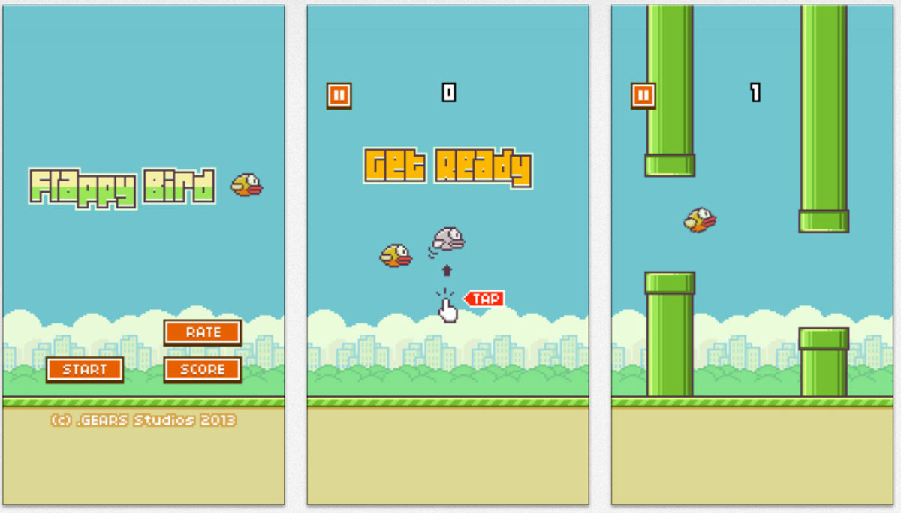
$50,000/Day

Slide 5
The Unity Editor
Notes:
Open unity now and show the New Project creation

Slide 6
Project View
Import a package
Explorer / Finder
Folder Structure
Adjustable
Preview
Favorites
Notes:
Import the code and art packages
Show Preview of a sprite

Slide 7
Scene Hierarchy & Scene View
Main Camera
Added by Default
Add objects to the scene by dragging from the project view
Drop to scene view or hierarchy
Press ‘F’ to focus on the selected object
Ctrl-D to duplicate
Notes:
Switch camera to Ortho
Add a Fish from the art folder to scene hierarchy
Focus on the Fish
Show the camera preview - Game view of Fish is next

Slide 8
Game View
Preview of what users will see
Stats and simple profiling
Resizable
Notes:
Show the game view with the Fish
Explain game view shows the camera’s view
Show Stats – FPS
Explain resizing for different platforms – Set different sizes

Slide 9
GameObjects / Components & Inspector
GameObject
Comprised of Components
Shown in the Inspector when the GameObject is selected
Inspector Tab
Shows details of the selected object(s)
Works for both the Scene and Project views
Add component will add scripts and functionality
Let’s add a RigidBody2D - Phsyics
Notes:
Explain GameObject – Comprised of Components / One is a transform / Can have children/parent
Explain Component – Comprised of code (ours/theres) / Parts in Inspector / Many Built-in
Fish has a sprite renderer – Show how to change the sprite
Add RigidBody2D and show it fall
Save the Scene

Slide 10
Scripts
C# code using MonoBehavior as the base class
Special methods you can override
Awake()
Start()
Update()
OnEnable()
OnCollission()
Lots more…
Notes:
SHOW
Explain Methods – Continue to Next

Slide 11
Fish code
Fields with [SeiralizeField] set show in the Inspector
Set FlightHeight to 200
Input.GetButtonDown(“Fire1”)
Left Mouse Button
Left Crtl
Button “A” on Xbox Controller
Tap on screen
Edit->Project Settings->Input
Notes:
Show and explain FishBasic.cs
Explain ProjectSettings “Input”
Adjust Flight Height

Slide 12
Obstacles - Seaweed
Dragged to Scene Hierarchy – Sets position to 0, 0, 0
Duplicate (Ctrl-D)
Use the Rotation property in the inspector to flip [x=180]
Adjust position in scene view or via inspector
PolygonCollider2D
Visible in Scene View only
Notes:
Fish still falls through, show this. Next slide adds collider
Don’t add code file yet
Single Seaweed – Adding more on Prefab Slide
Show it fall, then add polygoncollider and show it fall again (fish doesn’t have collider yet) – add on next slide
Anyone know what we need?

Slide 13
Collision
Need a collider on our Fish
Triggers
OnTriggerEnter
Notes:
Add the collider show it roll off
Switch to a trigger
Add seaweedPartBasic.cs watch fish fall and level restart – scene must be saved

Slide 14
Movement / Seaweed Parent
Fish only moves up and down
Seaweed moves
Parent for the 2 parts
Reset when too far left
Notes:
Create a gameobject and set the two seaweed parts as children.
Explain child offset and show it moving children
Add seaweedbasic.cs
Watch seaweed move.
Set SeaweedSpeed to 2.5
Will duplicate on NEXT SLIDE

Slide 15
Prefabs
Create by dragging a GameObject from scene hierarchy to project hierarchy
“Acts as a template from which you can create new object instances in the scene”
Changes to Prefabs are reflected in their instances in scenes
Modified values in the scenes are not auto updated
Notes:
Create a prefab then duplicate the seaweed 5x
Also keeps changes to children
Don’t change seaweed here. Gets changed much later

Slide 16
Ground
Quad (3D Object)
Ground.cs
Replace Meshcollider with BoxCollider2D
Set Trigger
OnTriggerEnter2D()
Notes:
Scale 20 Height -3.5
Add ground.cs set speed to 2.5
Show the trigger enter
BoxCollider2D

Slide 17
Intro to Unity Part 2
2D/3D/VR/AR
Notes:
Overview of what will be covered. 2D/3D Virtual Reality & Augmented Reality

Slide 18
Improvements
Game state / Pause
UI
Tilting
Props
Score

Slide 19
GameState
MonoSingleton
More complex in real application
Pause on start – Tap to play
Notes:
Open gamestate.cs - MonoSingleton (pattern available online)
Add gamestate object and connect the gamestate text for ispaused
Create a Text object then assign it to the fish.
“Press To Play”
Font Size = 28 / Color = White
Need to expand width & height
Switch SeaweedPartBasic.cs to SeaweedPart.cs – This calls Pause instead of loadlevel
Ground.cs – Change OnTriggerEnter to pausegame instead of loadlevel

Slide 20
Tilting
Fish.cs
GuiText _gameOver – Shows when the game ends
ScoreKeeper
Start()
Paused
Kinematic
Notes:
Swap fishbasic with Fish.cs Start and run, fish should drop
Show error in error window for the missing guitext – Fixed in next scene

Slide 21
Seaweed Upgrades
Pause Check
Random Height
Notes:
Change seaweedbasic to seaweed.cs
Create the new prefab and replace existing instances – In Scene 6

Slide 22
Props
Reuse seaweed.cs with range of 0
Place in front of ground
Notes:
Random Range = 0 / Z = -1

Slide 23
Scorekeeper
Handles scoring
Updates the UI
Add Bubble
Bubble.cs
Move to the right
Apply to prefab
Notes:
Create an empty gameobject, add the scorekeeper.cs script
Create a Text and assign it to the scorekeeper

Slide 24
2D Recap
Use colliders and rigidbody with 2D suffix
OnTriggerEnter2D
Verify Z axis for collisions
Sprites
PolygonCollider
Can also use 3d Objects
Camera mode – Orthographic
4.6/5.0 UI

Slide 25
3D
Let’s build a first person shooter

Slide 26
Differences from 2D
Same component & method names without the 2D suffix
Usually perspective camera
Meshes instead of sprites
Terrains

Slide 27
Terrain
Add Textures
Import Assetpack
Light - Directional
Deform
Notes:
Create a terrain and show it grey. Then import the terrain assets in the file import menu. Mention standard assets. Add a directional light then deform the terrain.

Slide 28
Sphere
SphereCollider – Automatically added
Rigidbody – Needed for movement
Notes:
Create a sphere in the main camera’s view and show it drop when it gets a rigidbody. Try to make it roll down a hill.

Slide 29
Character Controller
Import Package – CharacterController
Written in .js Better ones available on wiki
First person and third person prefabs
Notes:
Import the character controller package. Add the prefab and remove the original main camera

Slide 30
Projectiles & Pooling
Instantiation and GC are expensive on mobile
Pre-instantiate and use pools
GameObject.Instantiate
PoolManager
Set Projectile on PoolManager
Material to set color
Notes:
Create a new gameobject and add a poolmanager script.
Show the poolmanager code (better ones available or written in 10 mins) Use Generics
Create a red sphere, make it a prefab, and set it as the poolmanager prefab

Slide 31
Projectile Launcher
Handles “Fire1” just like the 2D sample
GameObject.FindObjectOfType<T>()
Has non-generic overloads
GetPooledGameObject()
AddForce – Similar to 2D sample
this.transform.forward – current gameobjects forward direction
Notes:
Add the projectilelauncher.cs script to the player

Slide 32
Projectile.cs
Self Destroy / Re-Queue
Time.deltaTime
Collision Detection
Notes:
After adding this, change the type to Continious Dynamic Discrete = Non Moving
Cont = Moving slow
Cont Dynamic = Fast Moving

Slide 33
Targets – The Asset Store
15,000 things on the store (8,000) models
Code Systems
Camera controllers
AI
Networking
Art
Audio
Editor Extensions
Free and Paid (Cost effective)
Let’s grab one
Notes:
Talk about the asset store then import the “Crate and Box” package
Developers can sell on the store

Slide 34
Adding the box
Add a Target script
Handles OnTriggerEnter()
GameObject.Destroy(this.gameObject)
Remove the mesh collider
Add BoxCollider
Notes:
Talk about GameObject.Destroy. Use this.GameObject or you’ll be trying to destroy the component not the object. BoxCollider vs Mesh Collider

Slide 35
Virtual Reality
Building for Samsung Gear VR

Slide 36
What’s Involved?
Get the SDK (Unity 4)
https://developer.oculus.com/downloads/
Install Android SDK
Replace the player controller or camera
Set SDK Location
Switch platform to Android
Notes:
These are all done, just show where to set the sdk location and swap the player controller for the OVR one

Slide 37
Augmented Reality
Vuforia

Slide 38
Vuforia Setup
Sign up on the Vuforia webpage
Download & Install the .unityPackage

Slide 39
Thanks
Demo Projects Avaialble
https://github.com/jweimann/Demos
Email: jasonweimann@gmail.com

